Slide 1
Injections and Medication Safety
Nursing

Slide 2
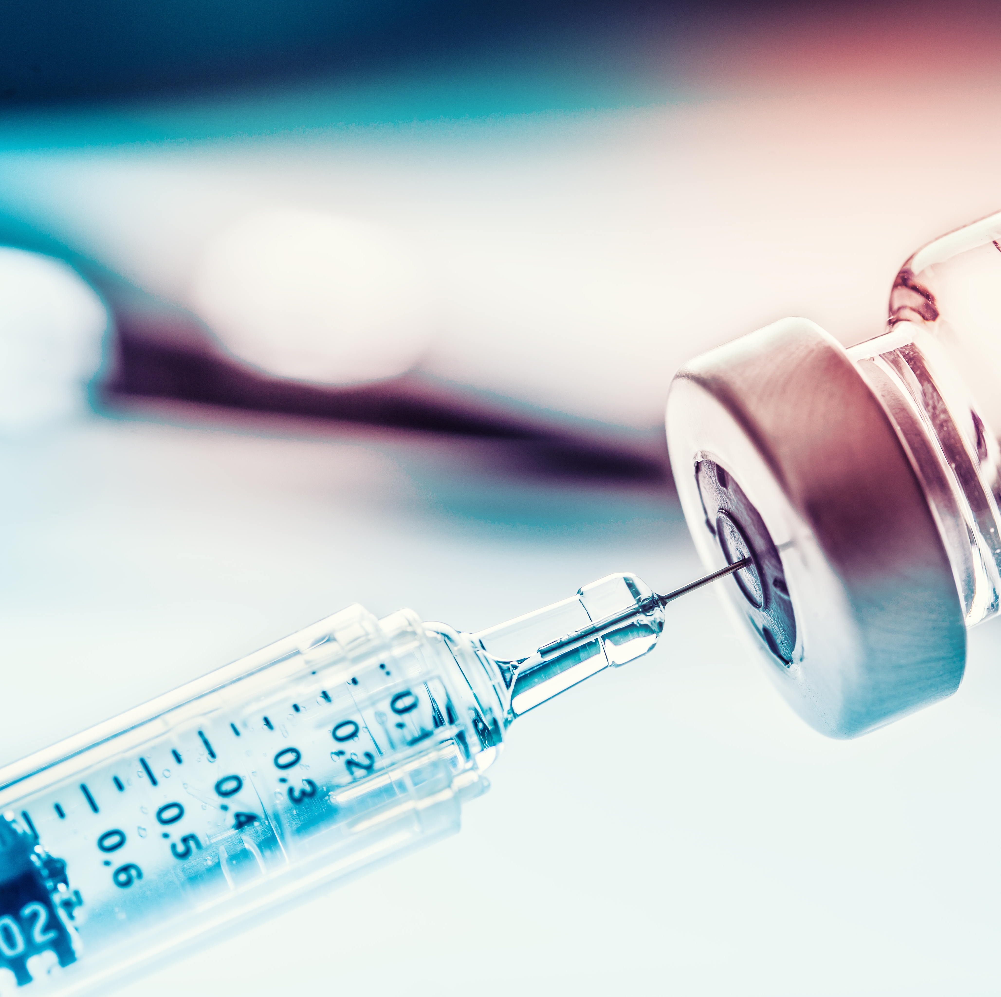
Introduction
Unsafe injection practices put residents and healthcare providers at risk. This harm is preventable.
A good rule to remember is One Needle, One Syringe, Only One Time

Slide 3
Unsafe injection practices may result in serious consequences
Unsafe injection practices may result in serious consequences like:
  Transmission of bloodborne pathogens such as hepatitis C virus (HCV), hepatitis B virus (HBV), and human immunodeficiency virus (HIV).
  Outbreaks of bacterial or fungal infections.
  Resident notifications about possible outbreaks and exposures to bloodborne or other pathogens, which may include advice on follow-up testing (e.g., for HCV, HBV, and HIV).
  Provider referrals to licensing boards for disciplinary action.
  Malpractice suits by residents or legally responsible parties

Slide 4
Basic Safe Injection Practices
Basic Safe Injection Practices:
  Prepare medications in a designated clean medication preparation area that is separated from potential sources of contamination, including sinks or other water sources.
  Always use aseptic technique when preparing and administering injections.
  Disinfect the access diaphragms of medication vials before inserting a device into the vial
  Use a new sterile syringe and needle for each resident. Once used, the syringe and needle are both contaminated and must be discarded.
  Do not administer medications from the same syringe to more than one resident, even if the needle is changed, or you are injecting through an intervening length of IV tubing.
  Do not enter a medication vial, bag, or bottle with a syringe or needle used on another resident.
  Enter medication containers with a new needle and a new syringe, even when obtaining additional doses for the same patient.

Slide 5
Basic Safe Injection Practices (cont.)
Basic Safe Injection Practices:
  Never use medications intended for single use for more than one resident. This includes single-dose vials, ampoules, bags, and bottles of intravenous solutions.
  Limit the use of multi-dose vials and dedicate them to a single resident whenever possible. Reused multi-dose vials should be kept and accessed in a designated clean medication preparation area, away from immediate patient treatment areas.
  Once a multi-dose vial is opened (e.g., needle-punctured) the vial should be dated and discarded within 28 days unless the manufacturer states another date for that opened vial. The beyond-use-date should never exceed the manufacturer's original expiration date.
  If a single-dose vial appears to contain multiple doses or contains more medication than needed for a single resident, do not retain it for future use, even on the same resident and do not combine (pool) or store leftover contents of single-dose vials for later use.

Slide 6
Resources
CDC Preventing Unsafe Injection Practices, Page Last Updated March 26, 2024 https://www.cdc.gov/injection-safety/hcp/clinical-safety/index.html
CDC Core Infection Prevention and Control Practices for Safe Healthcare Delivery in All Settings. Last updated April 12, 2024 https://www.cdc.gov/infection-control/hcp/core-practices/index.html

